Slide 1
Deep Dive into Office 365 with the Microsoft Graph API for Groups

Slide 2
Deep Dive into Office 365 with the Microsoft Graph API for Groups
</>

Slide 3
Agenda
Understanding Groups
Extensibility
Office 365 with the Microsoft Graph API for Groups
Coming soon

Slide 4
Developer vision

Slide 5
1
Understanding Groups

Slide 6
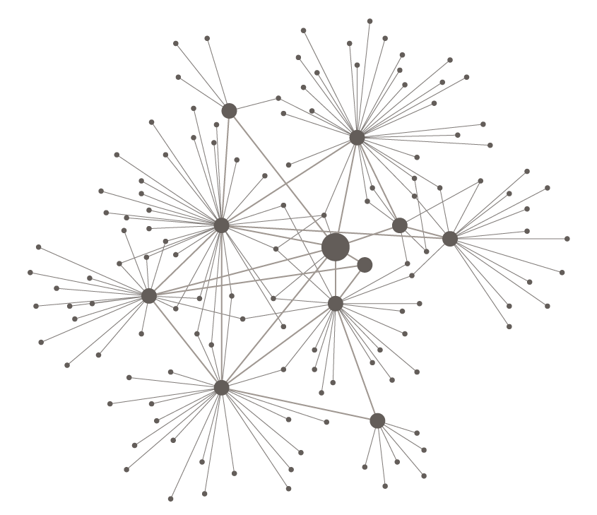
TRADITIONAL HIERARCHIES
RESPONSIVE NETWORKS
INFORMATION MOVES SLOWLY COMMAND AND CONTROL
INFORMATION TRAVELS FAST LEARN AND ADAPT

Slide 7
TRADITIONAL HIERARCHIES
RESPONSIVE NETWORKS
FIXED WORKFORCES SILOED TEAMS
LEVERAGE THE ON-DEMAND GLOBAL TALENT POOL

Slide 8
The rise of dynamic teams
Modern collaboration
Intelligent fabric
Personalized insight
http://dev.office.com/

Slide 9
Introducing Office 365 with the Microsoft Graph API for Groups
Brings together people, information, and apps across Office 365, to enable better communication and collaboration.
http://dev.office.com/

Slide 10
Office 365 with the Microsoft Graph API for Groups helps teams self-organize, work together across any tool of their choice, and build upon the expertise of others—it’s a key part of our vision for modern collaboration. The Microsoft Graph creates a standard definition for team membership across Exchange, OneDrive, and later Yammer, Skype for Business, and the rest of Office 365, managed through Azure Active Directory.
http://dev.office.com/

Slide 11
Introducing Office 365 with the Microsoft Graph API for Groups
Brings together people, information, and apps across Office 365, to enable better communication and collaboration.
http://dev.office.com/

Slide 12
Key benefits of Groups
Single definition
Public by default
Sharing to non-members
Self-service
Context and history
Simple to manage

Slide 13



Groups building blocks
Office 365 with the Microsoft Graph API for Groups
Azure Active Directory
Outlook
OneDrive
OneNote
Calendar
Skype
Dynamics CRM
Delve
Yammer
…
Apps

Slide 14
One group system across Office 365
One identity
Azure Active Directory (AAD) is the master for group identity and membership across Office 365 (Exchange, SharePoint, etc.)
Federated resources
Office 365 services extend with their data (e.g., conversations stored in Exchange mailbox and documents stored in OneDrive for a group)
Loose coupling
Services notify each other of changes to a group (e.g., creation, deletion, updates)
Using sync from AAD to Exchange Online AD and SharePoint Online AD they achieve reliability if they miss notifications
EXCHANGE
Exchange Online AD
Group mailbox
Conversations
Calendar
AAD
SHAREPOINT
Group identity
SharePoint Online AD
OneDrive for Business
Documents
OneNote
Identity
Resource URLs
Owners
Members
ADDITIONAL WORKLOADS
Local directory
Workload resources
Workload scenarios

Slide 15
Exploring Groups
demo

Slide 16
2
Extensibility

Slide 17
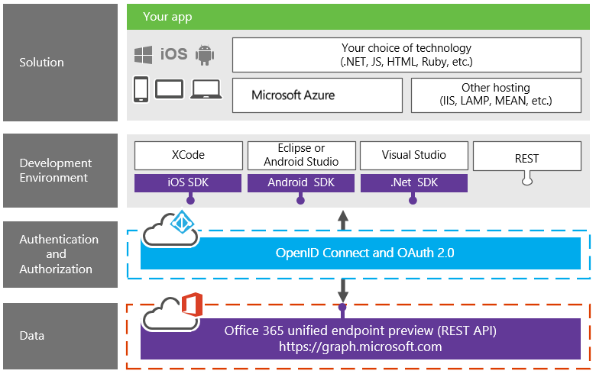
Office 365 platform overview

Slide 18
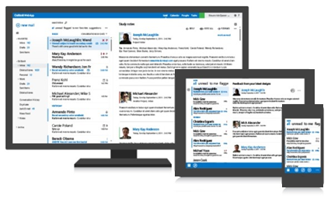
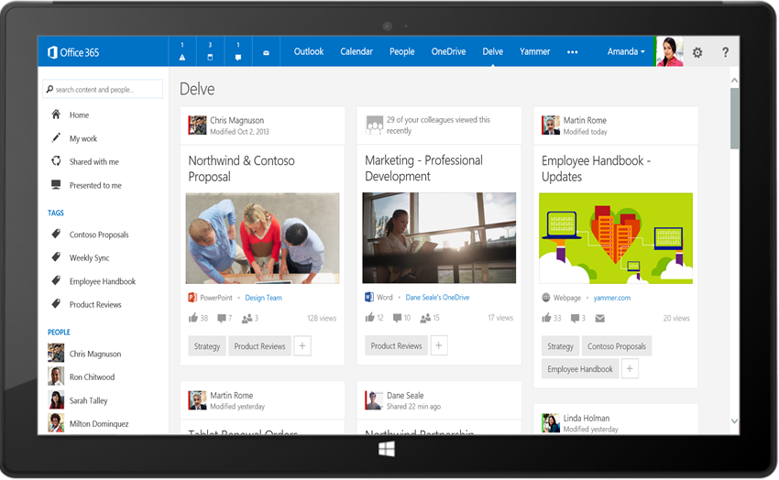
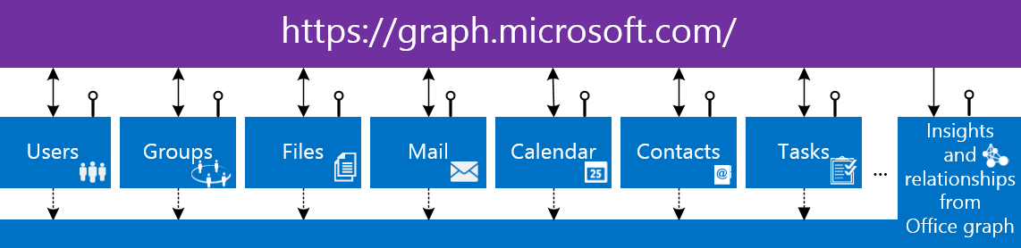
Microsoft Graph
Your app
https://graph.microsoft.com/
2

Slide 19
3
Office 365 with the Microsoft Graph API for Groups

Slide 20
Create Azure AD applications in Office 365 with the Microsoft Graph API for Groups
demo

Slide 21
https://graph.microsoft.com/v1.0/myorganization/groups?$filter=groupType+eq+'Unified'
MANAGEMENT
/CONVERSATIONS
/EVENTS
/drive/root/children

Slide 22
Building your app
Register app in Azure portal
Native
Web app
Single page app
Configure app permissions
Groups.Read.All
Groups.ReadWrite.All
Get token using OAuth2.0 flow
Use OpenID Connect for SSO
Build your code using Microsoft Graph

Slide 23
Groups management
Entities, collections, and actions
ENTITY | COLLECTION | ACTIONS
Group | Groups | CRUD SubscribeByMail, UnsubscribeMyMail, AddFavorite, RemoveFavorite, ResetUnseenCount
User/Me | Users | JoinedGroups
Collection
Samples
https://graph.microsoft.com/v1.0/contoso.com/groups/{id}/
https://graph.microsoft.com/v1.0/contoso.com/groups/{id}/microsoft.graph.addFavorite
Action

Slide 24
Groups content: Conversations
Blah
lol
Entities, collections, and actions
ttyl
ENTITY | COLLECTION | ACTIONS
Conversation | Conversations | Create, read, and delete
Thread | Threads | Reply
Post | Posts | Reply, forward
Attachment | Attachments | CRUD
Samples
https://graph.microsoft.com/v1.0/contoso.com/groups/{id}/conversations
https://graph.microsoft.com/v1.0/contoso.com/groups/{id}/threads/{id}/reply

Slide 25
Groups content: Calendar
Entities, collections, and actions
ENTITY | COLLECTION | ACTIONS
Calendar |  | Read
Event | Events | CRUD
Calendar view | N/A | Read
Attachment | Attachments | CRUD
Samples
https://graph.microsoft.com/v1.0/contoso.com/groups/{id}/events
../calendarview?startdatetime={start_datetime} & enddatetime={end_datetime}
Collection
No client-side recurrence expansion required

Slide 26
Groups content: Files
Entities, collections, and actions
ENTITY | COLLECTION | ACTIONS
File | Files | CRUD, upload, download
Folder |  | CRUD, enumerate children
Samples
https://graph.microsoft.com/v1.0/contoso.com/groups/{id}/drive/root/children
https://graph.microsoft.com/v1.0/contoso.com/groups/{id}/drive/root/children/{id}/

Slide 27
Common content queries
SCENARIO | URL
Get top 10 conversations sorted by LastDeliveryTime | /groups/{id}/conversations?$top=10&$orderby=lastDeliveredDateTime
Get the next 10 conversations | /groups/{id}/conversations?$top=10&$skip=10
Get selected properties on events starting after a particular date/time | /groups/{id}/events?$top=10&$select=Subject,Start,End&$filter=Start/DateTime ge '2014-09-22'
Get selected properties on conversation threads | /groups/{id}/conversations/{id}/threads/{id}/posts?$select=body
Get files where the name starts with “c” | /groups/{id}/drive/root/children?$filter=startswith(name,+'c')
Get selected properties on files | /groups/{id}/drive/root/children?$select=dateTimeCreated

Slide 28
Office 365 with the Microsoft Graph API for Groups
demo

Slide 29
4
Coming soon

Slide 30
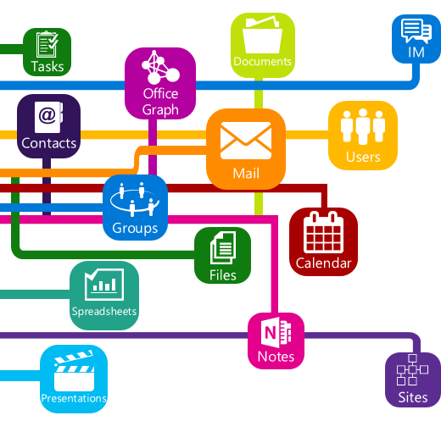
Roadmap
Files and pages
Invite guest users
Dynamics CRM
Extensible to third-party apps
eDiscovery and legal hold
Data loss prevention
Azure Active Directory Connect
Instant-on provisioning
Notifications
Get/set group photo
Full text search
Batching
Notes

Slide 31
Groups resources
Documentation
http://aka.ms/O365g
Questions
http://aka.ms/O365ng
Feedback
http://aka.ms/O365uv
Roadmap
http://roadmap.office.com

Slide 32
Summary
Understanding Groups
Extensibility
Office 365 with the Microsoft Graph API for Groups
Coming soon

Slide 33
Developer Program launch
1 YEAR FREE
Email Newsletters
Free Developer Subscription
Free Training
Free Tools
Webinars
http://dev.office.com/devprogram

Slide 34
Engage

